Slide 1
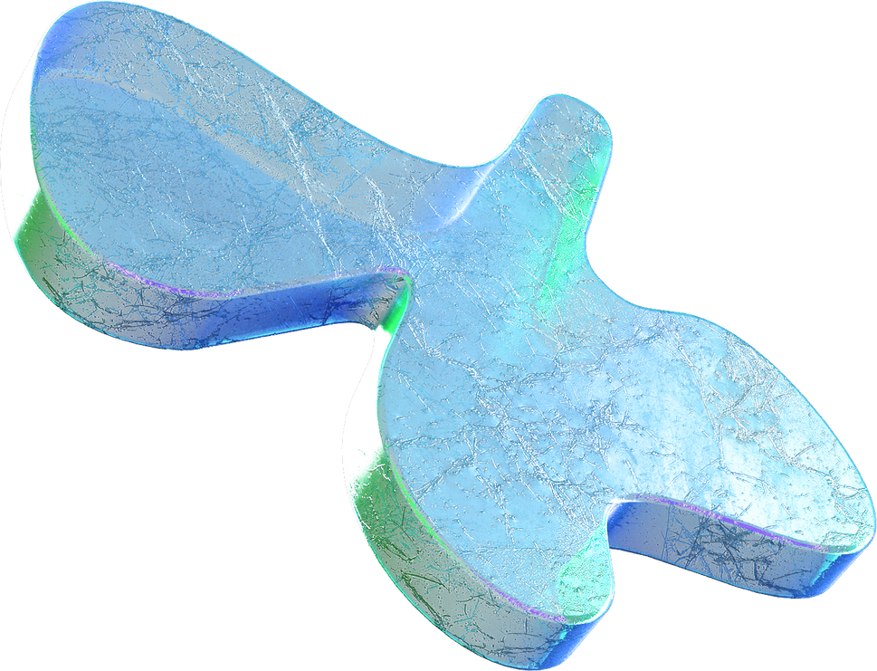
Unveiling the Heat Generation in Computation
What it is reversible computing?

Slide 2
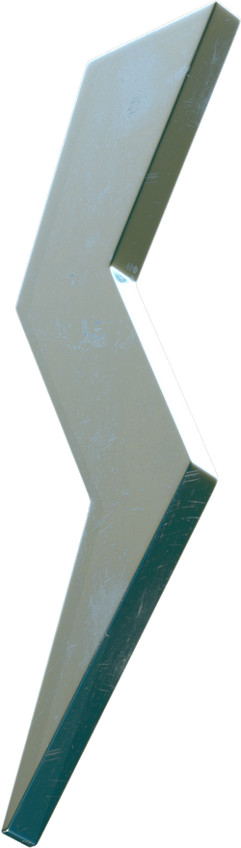
WHAT DOES A COMPUTER DO?
Fundamentally:
performs calculations a billion calculations per seconnd
remembers results 100s of gigabytes of storage!

Slide 3
Unique Nature of Computer Processors
Unlike other electrical devices, such as light bulbs or motors, computer processors do not primarily produce light, heat, or motion.
Processors are made up of millions of transistors, which act as electronic switches, controlling the flow of electricity through the circuits.
Processors perform millions or even billions of calculations per second, resulting in significant heat production.
More transistors = more clock cycles = more complicated instructions

Slide 4
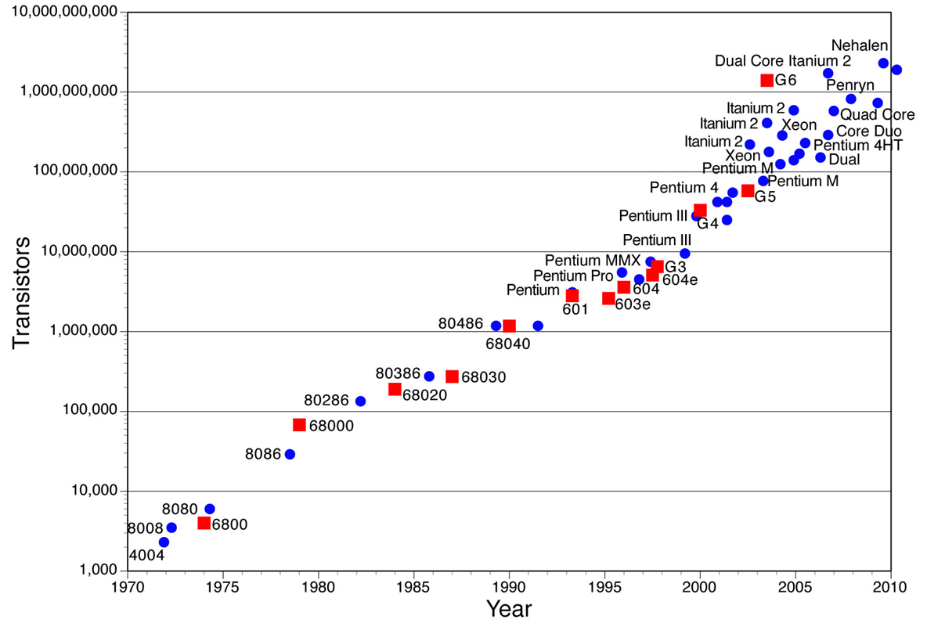
Moore’s Law
The number of transistors per chip doubles every 18 months

Slide 5
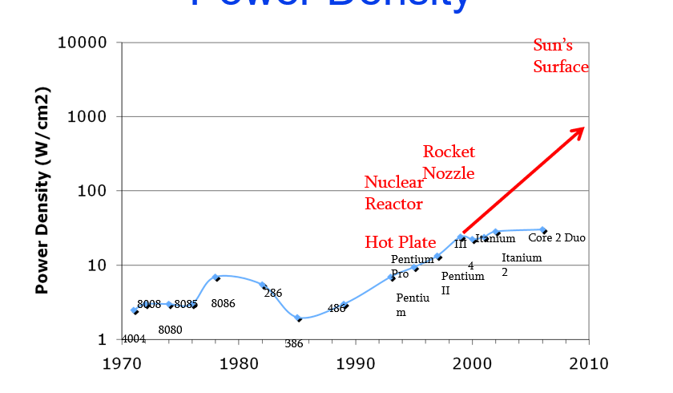
Power Density
Multi-core processors necessary to keep chips from melting

Slide 6
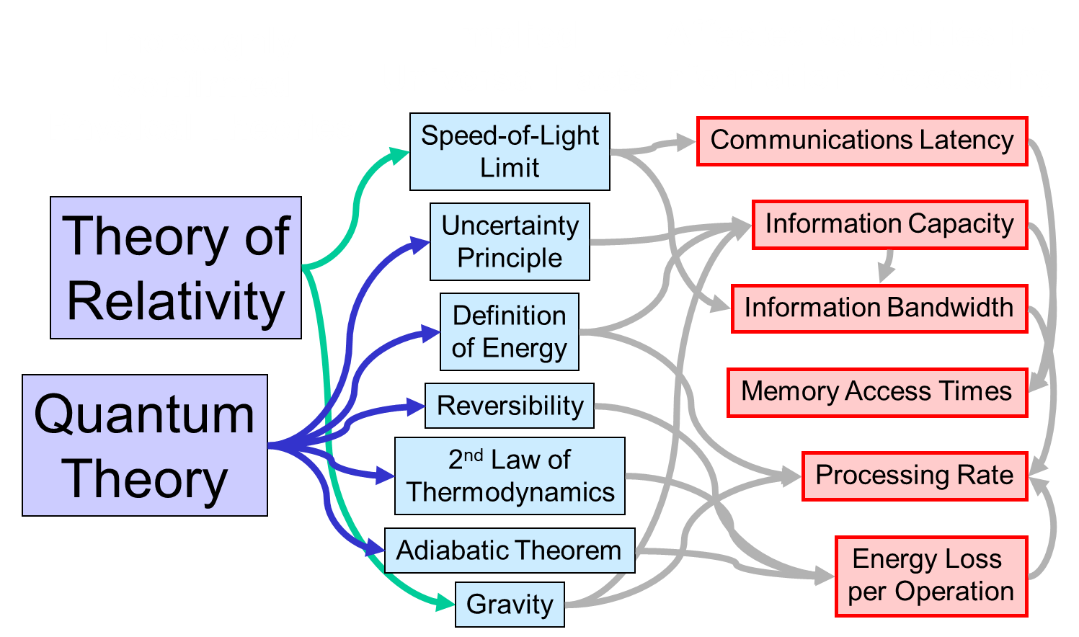
Fundamental Physical Limits of Computing

Slide 7
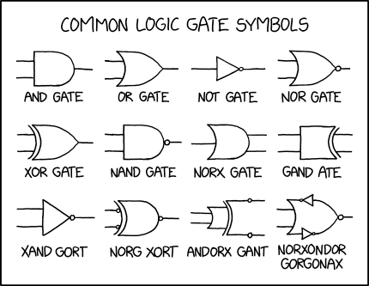
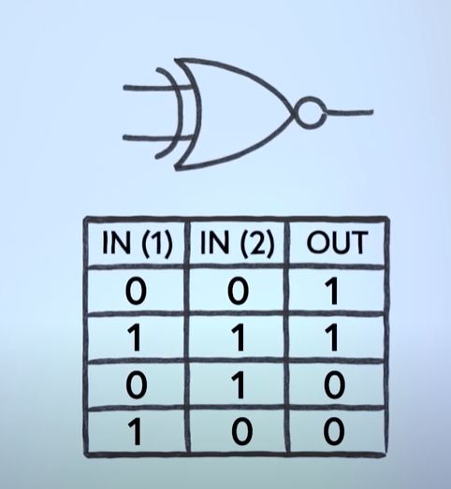
The Entropy problem

Slide 8
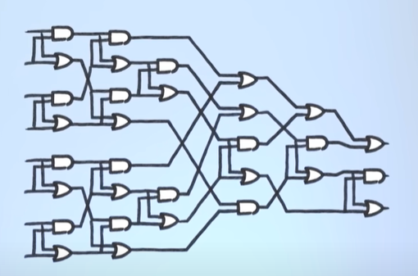
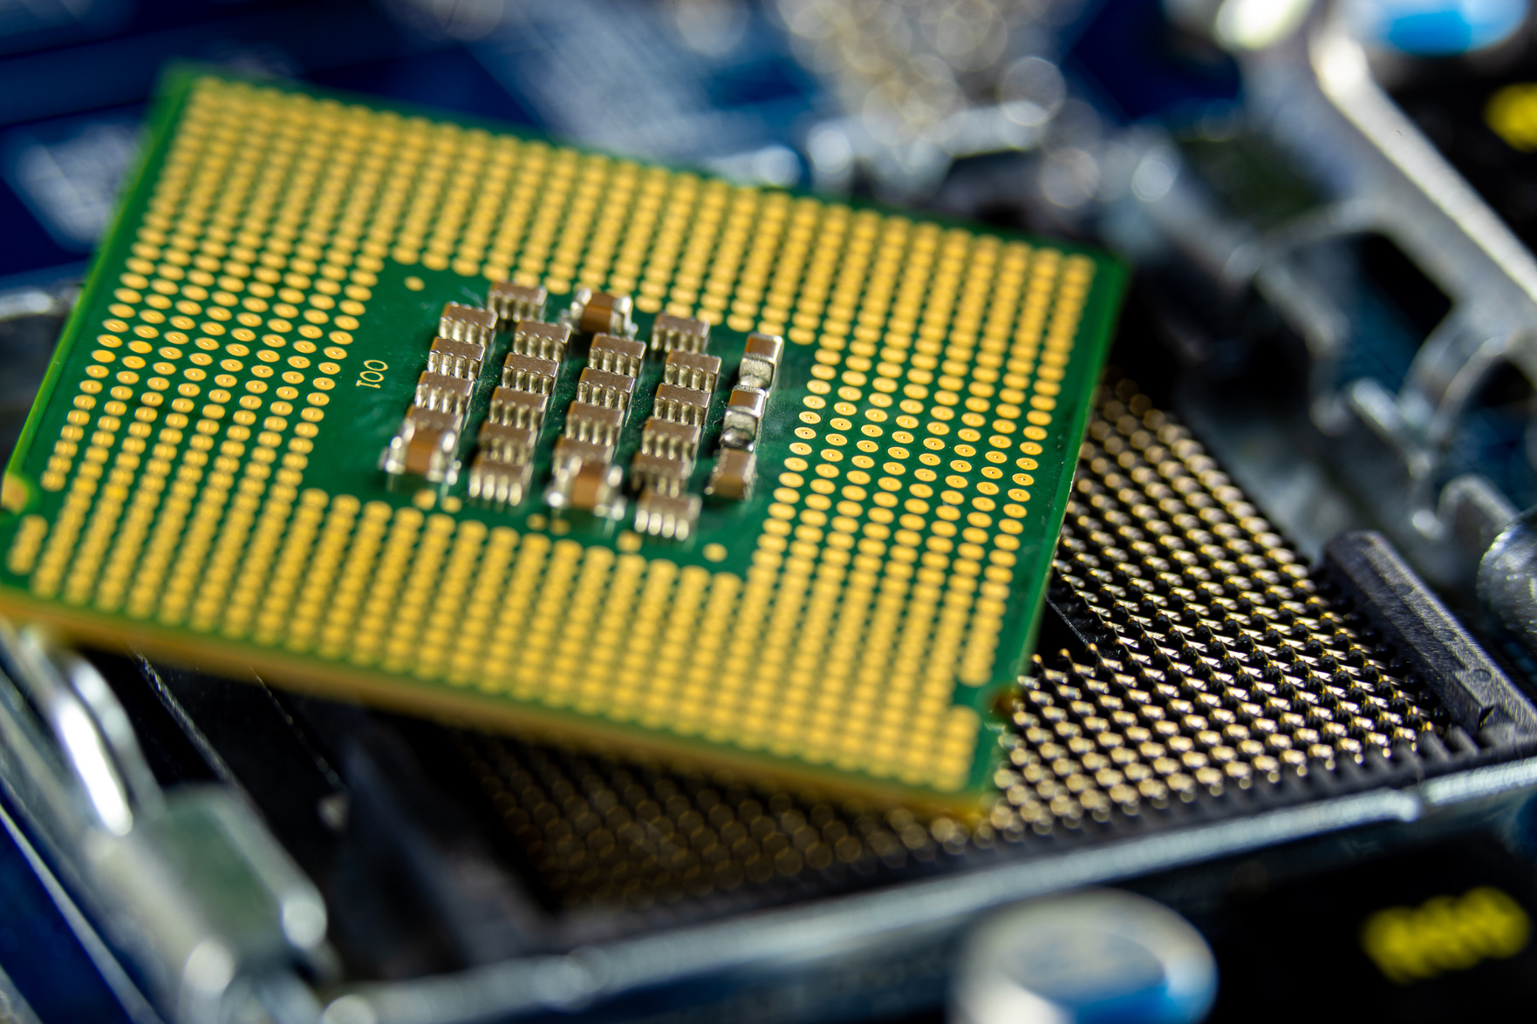
The Entropy problem
Both are the same

Slide 9
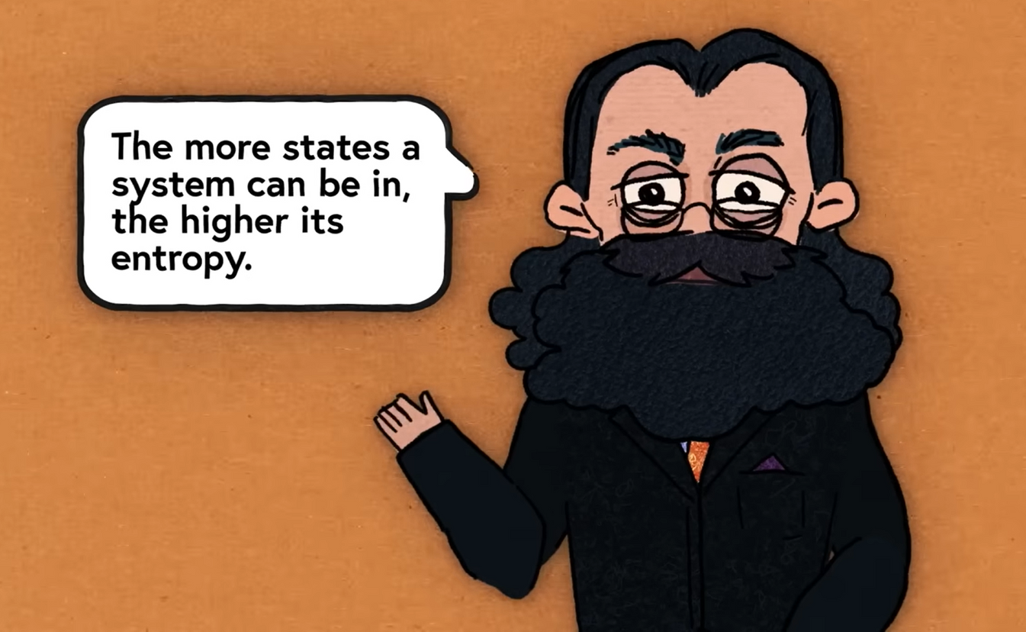
The Entropy problem
Entropy =
K LOG W
B
K
B
= 1.380649 x 10^-23 m^2 kg s^-2 k^-1
W = number of states

Slide 10
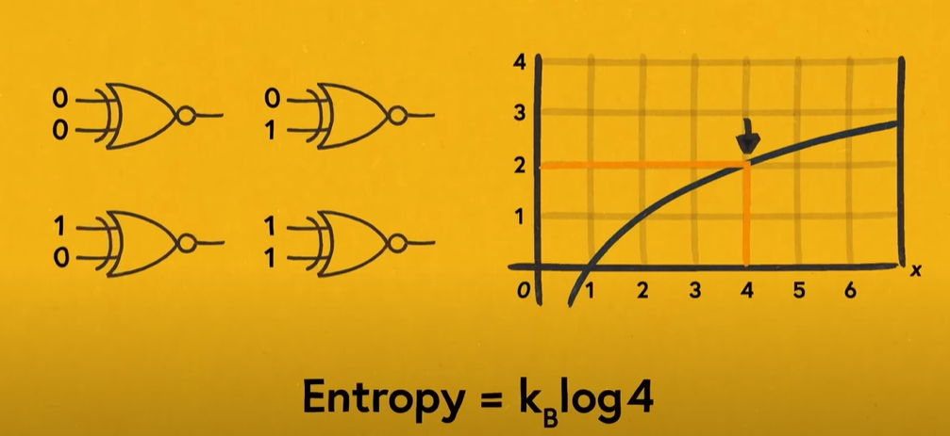
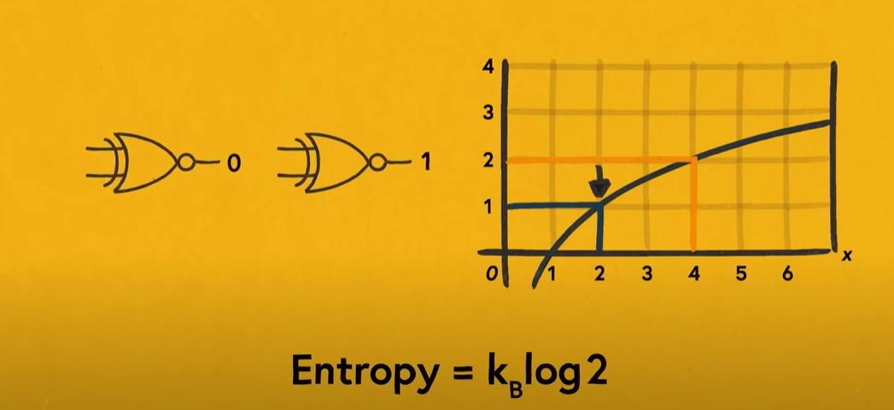
The Entropy problem
Entropy goes down?
Higher number of states to lower number states!

Slide 11
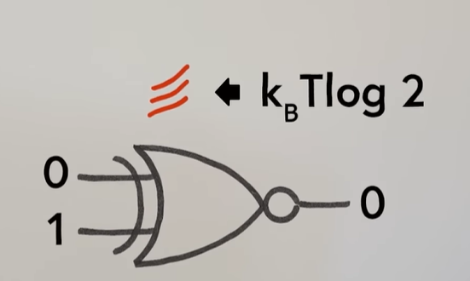
The Second Law of Thermodynamics
The state of entropy of the entire universe, as an isolated system, will always increase over time. The second law also states that the changes in the entropy in the universe can never be negative.
it doesnot mean entropy can not be decreased but the whole system entropy must incease or remain the same

Slide 12






The Energy Cost of Information
Landauer limit
The Landauer principle asserts that “the information is physical”.
Landauer’s principle states that there is a minimum possible amount of energy required to erase one bit of information
K TLOG (2)
=0.96x10^-23 T joules.
B

Slide 13
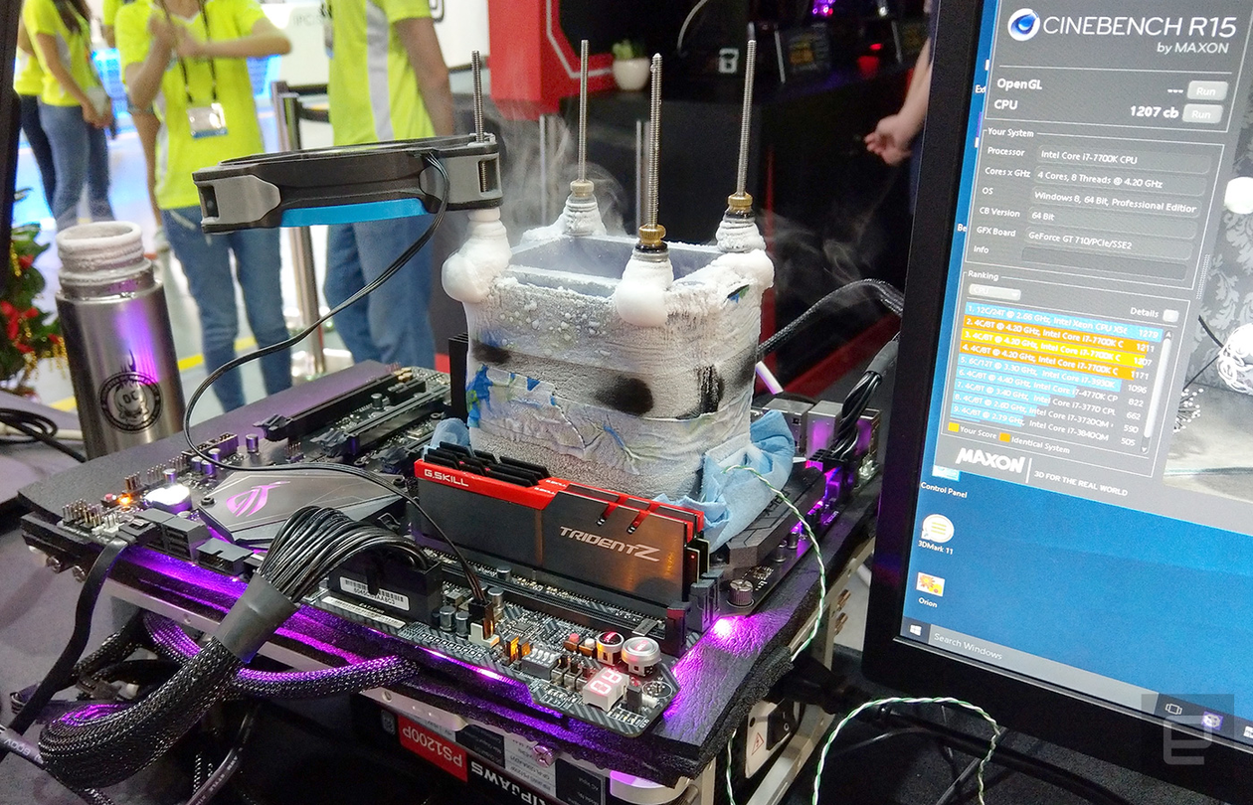

Cooling problem
More energy than before

Slide 14
Transcending the Energy Limits
We can transcend the traditional thermodynamic limits of
computing using new computing paradigms:
Reversible Computing – Absolutely required to reuse signal energies
and avoid Landauer’s limit
Generalized Reversible Computing – Clarifies the precise requirements to
avoid Landauer’s limit. More general concept of logical reversibility
2. Quantum Computing – Not the focus of this talk. About finding more
efficient algorithms for some problems using coherent trajectories.
Doesn’t address practical energy efficiency of general-purpose
computation

Slide 15
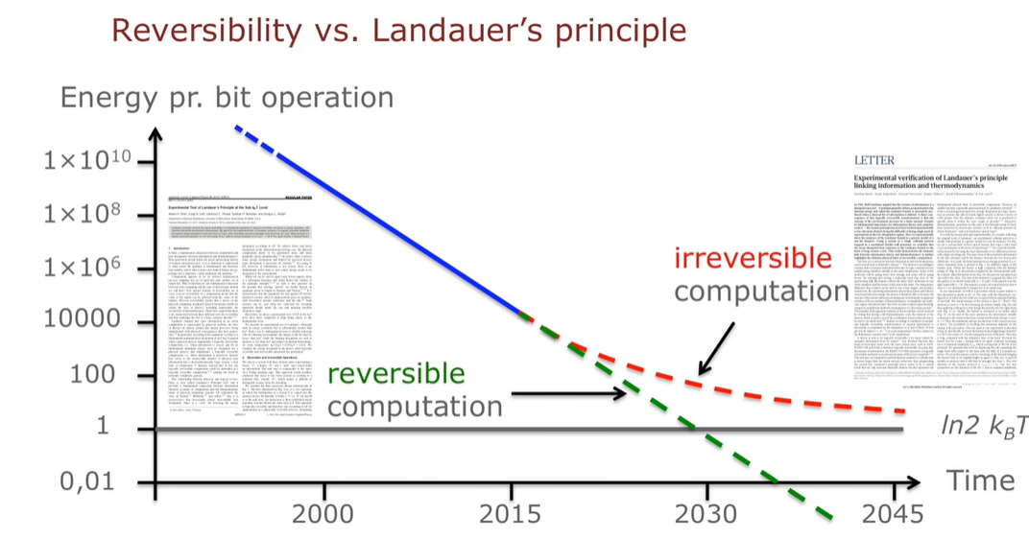
The limit eliminated

Slide 16

The Future of Computing
With device sizes fast approaching atomic-scale limits, ballistic circuits that conserve information will offer the only possible way to keep improving energy efficiency and therefore speed for most computing applications.

Slide 17
Thank you!

